Slide 1
Convolutional LSTM Network: A Machine Learning Approach for Precipitation Nowcasting 卷积LSTM网络:利用机器学习预测短期降雨
施行健
香港科技大学
VALSE 2016/03/23

Slide 2
Content
Quick Review of Recurrent Neural Network
Introduction to Precipitation Nowcasting (短期降雨预报)
Goal of Precipitation Nowcasting
Classic Approaches
Convolutional LSTM
Motivation
Formulation of the precipitation nowcasting problem
Model
Experiments

Slide 3
Content
Quick Review of Recurrent Neural Network
Introduction to Precipitation Nowcasting (短期降雨预报)
Goal of Precipitation Nowcasting
Classic Approaches
Convolutional LSTM
Motivation
Formulation of the precipitation nowcasting problem
Model
Experiments

Slide 4
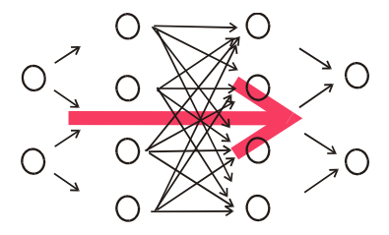
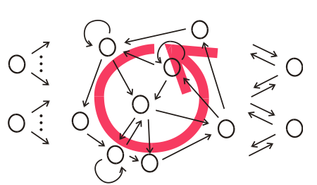
From FNN to RNN
Structural Generalization
Recurrent Neural Network can be arbitrary. Cycles are allowed in the network
Feedforward Neural Network is acyclic. There is no loop

Slide 5
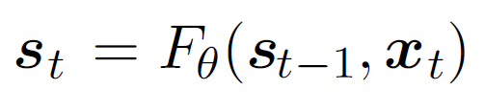
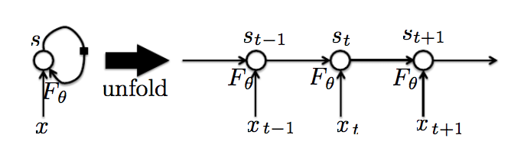
From FNN to RNN
After unfolding the structure, recurrent neural network can be viewed as a type of feedforward neural network with shared transitional weights
Example
Back propagation through time (BPTT)
Unfold the RNN to FNN
Use backpropagation, can use SGD and any of its variants
[Goodfellow et.al, 2016] Deep Learning (http://www.deeplearningbook.org/)

Slide 6
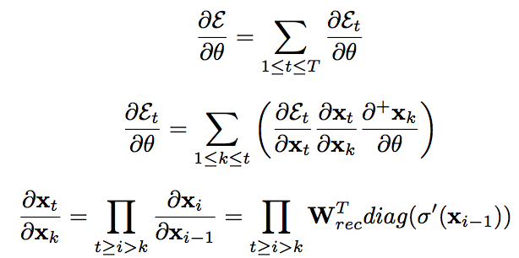
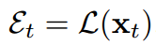
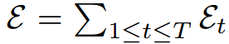
Vanishing Gradient & Exploding Gradient
Since the network is so deep, long term information in the gradient will contain a product of a large number of Jacobian.
This determinant will go to infinity or zero.
[PascanuI et.al, ICML2013] On the difficulty of training recurrent neural networks

Slide 7
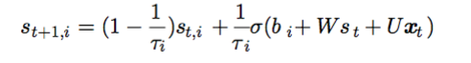
Constant error carousel to avoid vanishing gradient
Long term part of the gradient will contain a sum of product of Jacobians. It will not vanish if one of them does not vanish.
Long-Short Term Memory
Make det(Jacobian) → 1
Cell is the constant error carousel
Long-term information will be considered if we
initialize the bias of forget gate to a large value
[Jozefowicz et.al, ICML2015] An Empirical Exploration of Recurrent Network Architectures

Slide 8
Content
Quick Review of Recurrent Neural Network
Introduction to Precipitation Nowcasting (短期降雨预报)
Goal of Precipitation Nowcasting
Classic Approaches
Convolutional LSTM
Motivation
Formulation of the precipitation nowcasting problem
Model
Experiments

Slide 9
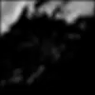
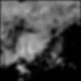
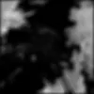
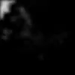
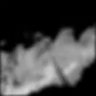

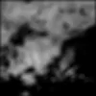
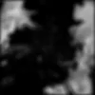
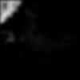
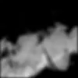
Goal of Precipitation Nowcasting
Give precise and timely prediction of rainfall intensity in a local region over a relatively short period of time (e.g., 0-6 hours)
High resolution & Accurate timing
High dimensional spatiotemporal data

Slide 10
Classic Approaches
Numerical Weather Prediction (NWP) based Methods
Build a model with several physical equations. Simulation.
More accurate in the longer term
The first 1-2 hours of model forecasts may not be available
Extrapolation based Methods
Optical flow estimation + Extrapolation (Semi-Lagrangian Extrapolation)
More accurate in the first 1-2 hours
[27th Conference of Severe Local Storm] ROVER by HKO
Hybrid Method
For the first several hours of now-casting, we use extrapolation based methods, while using NWP for longer term prediction

Slide 11
Classic Approaches
Black: Extrapolation
Red: Hybrid
Green: Corrected NWP
Blue: NWP
[Bulletin of American Meteorological Society 2014] Use of NWP for Nowcasting Convective Precipitation: Recent Progress and Challenges

Slide 12
Content
Quick Review of Recurrent Neural Network
Introduction to Precipitation Nowcasting (短期降雨预报)
Goal of Precipitation Nowcasting
Classic Approaches
Convolutional LSTM
Motivation
Formulation of the precipitation nowcasting problem
Model
Experiments

Slide 13
Motivation
The limitation of optical flow based methods
Flow estimation step and Radar echo extrapolation step are separated, accumulative error
Hard to estimate the parameters
A machine learning based, end-to-end approach for this problem
Machine learning based approach is not trivial
Multi-step prediction (size of the search space grows exponentially)
Spatiotemporal data (take advantage of the spatiotemporal correlation within the data)

Slide 14
Formulation of the precipitation nowcasting problem
Periodic observations taken from a dynamic system over a spatial MXN grid → sequence of tensors
Predict the most likely length-K sequence in the future given the previous J observations

Slide 15
How to perform multi-step prediction?
Encoding-Forecasting Structure
Using Recurrent Neural Network to encoding and forecasting
[NIPS2014] Sequence to sequence learning with neural networks
[ICML2015] Unsupervised learning of video representations using LSTMs

Slide 16
How to deal with spatiotemporal data?
A pure Encoding-Forecasting structure is not enough
We are dealing with spatiotemporal data!
X_{t+1}
X_{t+2}
X_{t+3}
X_{t+4}
LSTM
LSTM
LSTM
LSTM
LSTM
LSTM
LSTM
LSTM
X_{t-3}
X_{t-2}
X_{t-1}
X_{t}
NOT ENOUGH!!!

Slide 17
How to deal with spatiotemporal data?
We need to design a specific network structure for spatiotemporal data
What’s the characteristics of the spatiotemporal data we are dealing with?
Strong correlation between local neighbors, i.e, neighbors tend to act similarly
Fully-connected LSTM (FC-LSTM) → Convolutional LSTM (ConvLSTM)
Regularize the network by specifying the structure
Use convolution instead of fully-connection in state-to-state transition!

Slide 18
Comparison between FC-LSTM & ConvLSTM
FC-LSTM
ConvLSTM
Input & state at a timestamp are 1D vectors. Dimensions of the state can be permuted without affecting the overall structure.
Input & state at a timestamp are 3D tensors. Convolution is used for both input-to-state and state-to-state connection.
Use Hadamard product to keep the constant error carousel (CEC) property of cells

Slide 19
Convolutional LSTM
Using ‘state of the outside world’ for boundary grids. Zero padding is used to indicate ‘total ignorance’ of the outside.
In fact, other padding strategies (learn the padding) can be used, we just choose the simplest one.
FC-LSTM can be viewed as a special case of ConvLSTM with all features standing on a single cell.
States
Inputs
For convolutional recurrence, 1X1 kernel and larger kernels are totally different!
Later states → Larger receptive field

Slide 20
Convolutional LSTM
With the help of convolutional recurrence, the final state has large receptive field
X_{t+1}
X_{t+2}
X_{t+3}
X_{t+4}
ConvLSTM
ConvLSTM
ConvLSTM
ConvLSTM
ConvLSTM
ConvLSTM
ConvLSTM
ConvLSTM
X_{t-3}
X_{t-2}
X_{t-1}
X_{t}

Slide 21
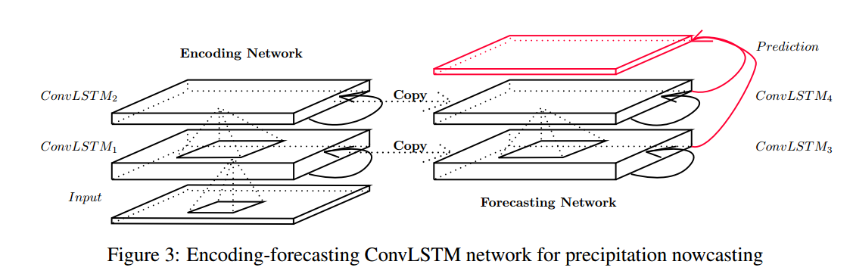
Final Structure
Cross Entropy Loss + BPTT + RMSProp + Early-stopping

Slide 22
Experiments
Experiments on a synthetic Moving-MNIST dataset
Gain some basic understanding of the model
Test the effectiveness of ConvLSTM on synthetic data.
Experiments on the real-life HKO Radar Echo dataset
Test if the proposed approach is effective for our precipitation nowcasting problem.

Slide 23
Moving-MNIST
2 characters bouncing inside a 64X64 box
10000 training sequences + 2000 validation sequence + 3000 testing sequences, 10 frames for input & 10 frames to predict
Different parameters of the model.
Convolutional state-to-state transition is important! Kernel Size >1 is important!

Slide 24

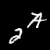

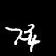
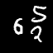
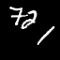

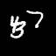
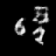
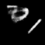
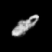
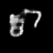
Moving-MNIST
Out-of-domain test
How the model performs for out-of-domain samples? Generate dataset with 3 characters.
Input
Truth
Prediction

Slide 25
HKO Radar Echo
Slice several separated training & testing sequences. 5 frames for input & 15 frames to predict. The size of each frame is 100X100.

Slide 26





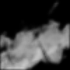
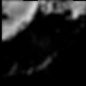
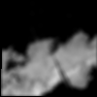
HKO Radar Echo
Input
Truth
ConvLSTM
ROVER2

Slide 27
Discussion
ConvLSTM for other spatiotemporal problems like human action recognition and object tracking
[Ballas, ICLR2016] Delving deeper into convolutional networks for learning video representations
[Ondru´ska, AAAI2016] Deep Tracking: Seeing Beyond Seeing Using Recurrent Neural Networks
Imposing structure in recurrent connection.

